Slide 1
Four Years of Scholarworks@UNO
Lessons Learned,
Continuing Challenges
Jeanne Pavy, Scholarly Communications Librarian
University of New Orleans
April 17, 2017

Slide 2
A little background on UNO . . .
A comprehensive urban research university offering over 80 degree programs, including 38 graduate programs (11 of which are PhD programs).
Faculty: 281 full-time and 116 part-time.
~13% of UNO students come from 42 other states and 74 other countries.

Slide 3
It’s been a rough 10 years.
August 2005 (pre-K)
> 17,000 students
Library materials budget: ~ $2.7 million
49 total library staff
Today
< 10,000 students
Library materials budget: ~ $1.3 million
24 total library staff

Slide 4
Why create an Institutional Repository at the University of New Orleans?

Slide 5
Three main reasons . . .
ACRL Scholarly Communication Roadshow - Summer 2009
Diminishing purchasing role for the library (relentless budget cuts)
Direct experience of a dysfunctional scholarly communications system.

Slide 6

A Shifting Role for the Library
From being the “campus wallet” that pays for access to information . . .

Slide 7

. . . to becoming a partner with faculty and students in creating and sharing the University’s research & scholarship.

Slide 8
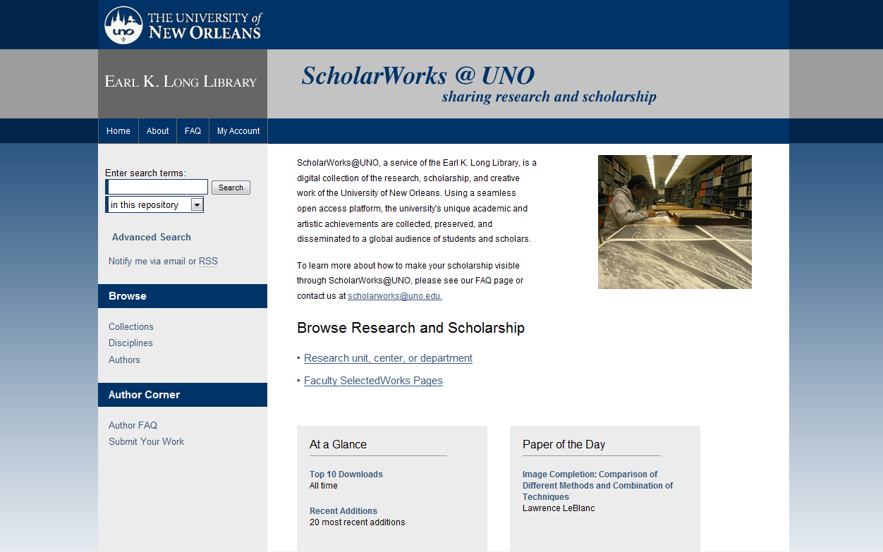
ScholarWorks@UNO Launched
March 2011

Slide 9
Staffing
Scholarly Communications Librarian
  Overall management of the IR
  Create policies, procedures, etc.
  Training for other librarians, staff
  Create new series, conferences, etc.
Subject Liaison Librarians (currently 6 of them)
  Promote services to departmental faculty
  Upload for most faculty pubs

Slide 10
Content Needed!
Initial focus was on collections that we already had online through a shared state repository:
Electronic theses and dissertations
Internship Reports
Older working paper series

Slide 11
Outreach to Faculty
Made presentations at meetings of deans and department chairs.
Liaison librarians followed up with emails to faculty whose work they identified as eligible for the repository.
Regular appeals to deposit work as part of beginning-of-semester emails to faculty.
Take every opportunity to suggest putting work in ScholarWorks.

Slide 12
Outreach to Centers and Institutes
Usually a one-on-one appointment with the Director.
Many are public-oriented and “outward-facing” so they are likely to grasp benefits.
Examples:
  Center for Hazards Assessment, Response & Technology
  UNO Transportation Institute
  Survey Research Center

Slide 13
Outreach to Other Units and Offices
Public Relations Office
Office of Research
Literary journal published on campus (Ellipsis)
UNO Press

Slide 14
Where are we now?
4,095 items
47 collections (“series”)
    One journal, one magazine archive
    Three conferences
950,402 downloads

Slide 15
Items Added per Year

Slide 16
Who has Contributed?
Sciences
Biology
(29)
EES
(11)
Centers & Institutes
CHART
(43)
DBER
(38)
PIES
(4)
Computer Science
(1)
Engineering
Liberal Arts
Education
Business
Library
Civil & environmental
Library Faculty
(5)
Curriculum & Instruction
(3)
ELCF
(3)
Mechanical
Accounting
Economics & Finance
HRT
Mgmt & Mkt
(7)
Student Work
Honors Program
(68)
Graduate School
(1833)
NAME
SEHS
AMRI
(35)
Anthropology
(1)
Chemistry
(46)
Electrical Engineering
(123)
English
(92)
Mathematics
(24)
Physics
(67)
Psychology
(6)
UNO Poll
(36)
Arts Admin
(176)
Fine Arts
Foreign Languages
(48)
Geography
Film & Theatre
History
(4)
Music
Philosophy
(5)
PLUS
(25)
Political Science
(7)
UNOTI
(17)
Sociology
(3)
Center Austria
Eisenhower Center
ECCC
GNOCIA
IEDRES
Midlo Center (69)
NCAM
NOJI

Slide 17
Downloads per Year

Slide 18
Who visits ScholarWorks@UNO?
Visitors have come from 188 countries

Slide 19
Most popular countries . . .
1. United States | 94,991 (67.87%)
2. United Kingdom | 4,956 (3.54%)
3. India | 4,312 (3.08%)
4. China | 2,974 (2.12%)
5. Canada | 2,813 (2.01%)
6. Germany | 1,833 (1.31%)
7. Australia | 1,747 (1.25%)
8. Iran | 1,180 (0.84%)
9. Japan | 1,022 (0.73%)
10. Malaysia | 1,000 0.71%)

Slide 20
Visitors from every U.S. state
(including Mississippi – #16 with 1082 visits)
Louisiana | 34,480 (36.30%)
California | 17,774 (18.71%)
Texas | 4,840 (5.10%)
New York | 3,729 (3.93%)
Florida | 2,646 (2.79%)
Illinois | 1,881 (1.98%)
Pennsylvania | 1,771 (1.86%)
Georgia | 1,767 (1.86%)
Massachusetts | 1,668 (1.76%)
Maryland | 1,661 (1.75%)

Slide 21

Lessons Learned:
Outreach

Slide 22

Some people might not know what you are talking about . . .

Slide 23
Try to find alternatives to
“Institutional Repository”
Online Archive
Digital Collection
Publishing Platform

Slide 24
Make them an offer they can’t refuse.
Make it easy to say “yes.”
Check copyright status of publications
Offer to upload material.
Provide as much metadata as you can.

Slide 25
Subject: permission to include article in ScholarWorks
Dear Professor _____,
I recently came across [one/many] of your [article/articles]—“{article title}” in {Journal title}. The article is eligible for posting in ScholarWorks@UNO--our online institutional repository. . . .
Your article will have a permanent, separate URL that can be pasted into any email, vita, or hypertext document, or linked to from any blog or other webpage.
Online open access articles are viewed and cited much more frequently than those available only in paper or only by limited subscription. It is one of the best ways to maximize the impact of your research. By participating in ScholarWorks@UNO you will also get an automatic monthly report by email on how often each of your documents is downloaded.
May we have your permission to proceed? If we identify additional articles or material you have published, may we have permission to include those as well (always considering the publisher's policies and guidelines)?
I’m more than happy to explain procedures and policies in greater detail, at your convenience.
Sincerely,
Your Liaison
[adapted from template provided by Paul Royster, University of Nebraska-Lincoln]

Slide 26
Show examples from peer groups.
Show a collection of articles that are online from a colleague in the same department or college.
Show how other institutions are using their repository to highlight student work, art, music, etc.
Show examples of similar conferences, etc.

Slide 27

Show them the Numbers
Share total downloads for faculty publications in a department.
Announce the top 10 faculty downloads annually.

Slide 28
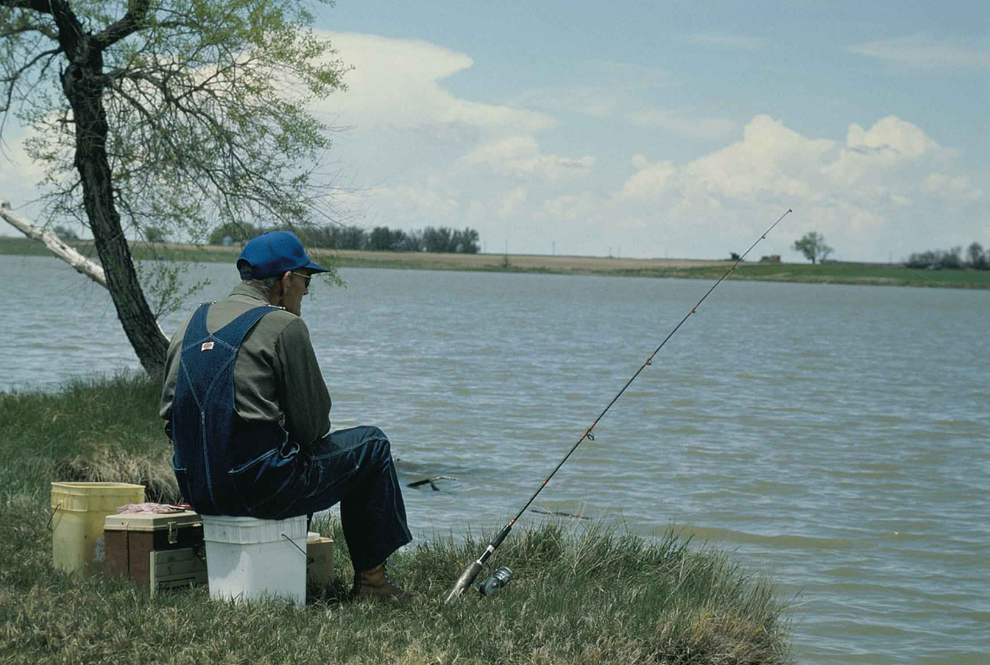
Be patient! Keep trying!

Slide 29
Lessons Learned:
Benefits and Rewards

Slide 30
ScholarWorks creates connections with students.
Through:
Graduate School
Honors Program
Undergraduate Research Event
Allows us to address:
Copyright compliance
Author rights
Publishing options, CC licenses, Open Access

Slide 31

ScholarWorks “saves” material that might otherwise disappear.
Conference Content
Student Work
Studies, Reports

Slide 32
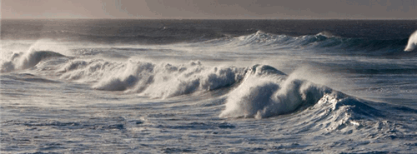
Ocean Waves Workshop
“ScholarWorks is essential to ensure that ideas developed during the workshop are made available to others in a responsible manner . . . .
[The UNO Library] has been very helpful in bringing this event to life through ScholarWorks.”
--Ocean Waves Workshop organizer

Slide 33
Wavelength: New Orleans Music Magazine (1980-1991)
“I was noticing this morning that in this short time, Wavelength already has 628 downloads from Scholarworks, 61 just this past week from places like Zhongxin and Beiing China, Morocco, Moscow, Yemen, etc! As we thought, the addition of Wavelength will get UNO’s name far and wide! ”
-- History professor & editor of Wavelength: New Orleans Music Magazine
http://scholarworks.uno.edu/wavelength

Slide 34

ScholarWorksallows us to give back to our local community.
Coastal research
Disaster Preparedness
Transportation studies
Political polls
Economic trends & analysis
Urban planning

Slide 35

Faculty are grateful that new readers are discovering their work.

Slide 36
“Thanks much for helping me to get the Balaam article published . . . it was published in an out-of-the-way journal, and via this method, may get into the "mainstream" of a couple of things -- bible as literature specialists; bible specialists in general; old testament scholars, etc. -- or at least will have a chance of doing so.”
-- English professor

Slide 37
”I want you to know how happy these statements make me. It's wonderful to know that some people out there are reading [my work]. Amazing that more than 100 people have perused what I said about "Alien Encounters.” I sincerely want to thank you for helping me get my name out there.“
- English professor

Slide 38
Benefits to the Library
Richer understanding of faculty research interests
Opportunity to engage faculty on scholarly communication issues (author rights, open access)
Provide a valuable service that raises the profile of the University and increases the impact of our research & scholarship

Slide 39
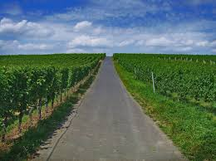
Looking Ahead
What will ScholarWorks look like four years from now? . . .
We hope that it will evolve to meet the needs of the University, and provide value to our students and faculty.

Slide 40
Credits
Slide #40: The road ahead is empty. – Christiaan Triebert
https://www.flickr.com/photos/christiaantriebert/3539339874/
All other images public domain.

Slide 41

Questions?

