Slide 2
2014 Research Agenda
University of Southern Mississippi
Richard Dunfee
Sandra George
Richard Wellons

Slide 3
Notable FY 12 Winners
National Science Foundation (+2.5%)
National Institute of Standards and Technology (+0.1%)
Technology Innovation Program and Advanced Manufacturing Consortium Program funding was eliminated. Manufacturing Extension Partnership was preserved.
U.S. Department of Defense
Basic and Applied Research (+6.5%)
10% increase for university partnerships.
U.S. Department of Energy
Office of Energy Efficiency and Renewable Energy (+36.7%)
Office of Science - $4.5 B (+4.9%)
Advanced Research Projects Agency-Energy (ARPA-E) (+53.1%)
U.S. Department of Transportation - $1.1B (+6.4%)
University Research Centers budget was cut by 25%.
Medicare/Medicaid, AHRQ, Health IT funding modest increase

Slide 4
Notable FY 12 Losers
U.S. Department of Agriculture R&D (-6%) Note: National Institute for Food and Agriculture and Food Research Initiative were spared significant cuts.
National Aeronautics and Space Administration (-3.5%)
National Oceanic & Atmospheric Admin (-4.3%)
U.S. Department of Homeland Security Research, Development, and Innovation accounts (-59.7%)

Slide 5
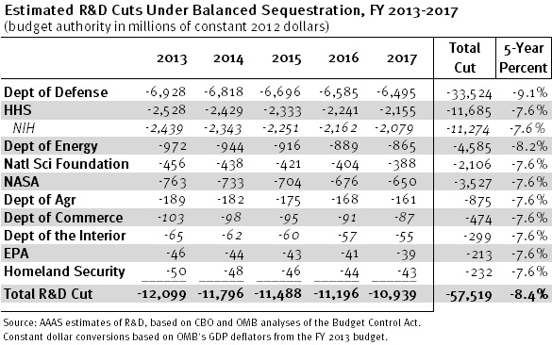
Sequestration

Slide 6
Total Commitment to R&D from All Sources
$415 2010
$428 2011
$437 2012
?$436? 2013
$464 2014 (projected)
in billions
Source: Batelle, R&D Magazine

Slide 7
What FY 14/15 Budget Deal Means for Applicants
Budget Outline Due January, 10, 2014
No more CR Deadlines through 2014
Next Debt Ceiling Deadline Second Week of February, 2014
Defense, Medicare/Medicaid, Social Security, Investments in Job Creation and Innovation
Program Competitions Fast/Furious beginning the last week of January, 2014
© AAASC/GRC, 2012

Slide 8
What FY 14/15 Budget Deal Means for Funding
Spending ceilings increase
Non-defense discretionary (NDD) spending from $469 to approximately $492 billion in FY 14 and 15 (+4.9%)
Defense discretionary spending from a previous cap of $498 to $520 billion in FY 14 (+4.4%)
Optimism -- the stability of two year budget and morale of a 1% pay increase
© AAASC/GRC, 2012

Slide 9
OMB Revises Grants Management Guidance
Final rules released December 26, 2013
Federal Register notice, the Office of Management and Budget
Replaces many of the regulations guiding the daily work of research and sponsored programs administrators, including Circulars A-21, A-122, A-133, and Circular A-50 Single Audit Act guidance.
© AAASC/GRC, 2012

Slide 10
Priorities FY13-14
Health Education & Research
Health Providers (nursing and therapies)
Public Policy
Social and Behavioral Sciences
Occupational Science
Psychology and Behavior
STEM Education
Inter-system relationships (pipeline)
Technology
Health Ecology
Social Equity and Engagement
Employment and Workforce
Innovation
Entrepreneurship
© AAASC/GRC, 2013

Slide 11
Priorities FY13-14
Energy Economy
Sustainability (Environ & Econ)
Innovation
Eco-Systems
Regional Leadership
Entrepreneurship
Workforce
Public/Private Partnerships
Interactive Planning
Workforce Interventions
Access to Private Financing
Cultural Issues
Faculty/Student Engagement
© AAASC/GRC, 2013

Slide 12
= Program Priorities
Innovation Transfer and Applied Research
Entrepreneurial Activity
Partnerships
Employment/Workforce Development
Social Equity (income inequality, gender equality, voting rights, education access)
METRICS…METRICS…METRICS

Slide 13
Private/Public and Public/Public Partnerships

Slide 14
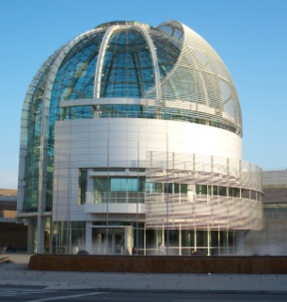
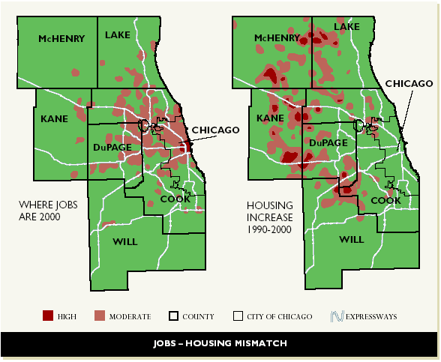
Enhance Regional Clusters
Supporting the Innovation Ecosystem
Supporting
Public-Private
Partnerships
Human Capital
Leverage Points
for Sustainable
and Inclusive Prosperity
Spatial Efficiency
Innovation-
Infrastructure

Slide 15
Office of Innovation & Entrepreneurship
I6 Challenge
Broad topics – food, energy, defense, education, life sciences
Partnerships with 13 Major Federal Agencies
Next competition expected in FY 14
NACIE University President’s Letter – 148 Universities
Student/Faculty Entrepreneurship
Technology Transfer
Industry Collaboration
Regional Economic Development
FY 14 meetings expected to restart in Spring 2014
Investing in Manufacturing Communities Partnership (IMCP)
Obama Administration initiative to accelerate the resurgence of manufacturing and create jobs in cities across the country
$7 million in FY 13 funding to support : Workforce training, Specialized research, Strengthened supply chains, Improved transportation/energy infrastructure, Export promotion, Better access to capital
Make it In America Challenge
Held 3 competitions in FY 13
Obama Administration awarded $25 million in funding last October
15 National Lab Directors
Commercializing research conducted at federal labs
OIE
Notes:
Link to the IMCP details: http://www.eda.gov/news/pressreleases/2013/09/25/american_manufacturing.htm
This is new brain child that took the place of the Jobs and Innovation Accelerator Challenge
Make it In America Challenge: The overall objective of the Make it in America Challenge is to make it more attractive for businesses to build, continue, or expand their operations in the United States. $20.5 million in Make it in America funding comes from the Department of Commerce's Economic Development Administration, the Department of Labor's Employment and Training Administration, and the Delta Regional Authority.

Slide 16
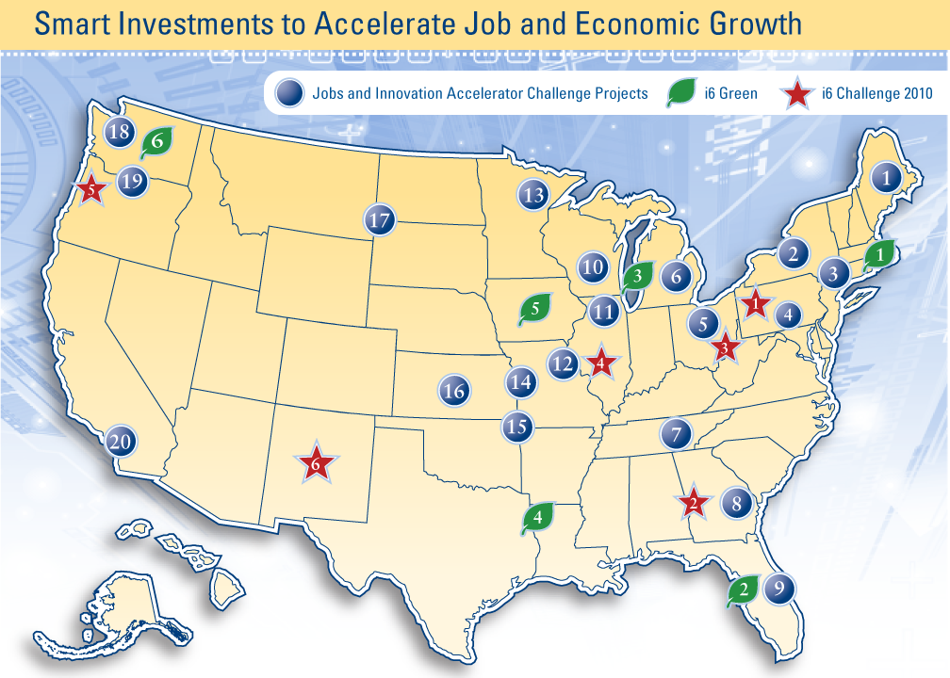
Innovation. Regional Collaboration. Job Creation.
EDA’s Challenge Grants Accelerated 32 Projects in 2010 and 2011

Slide 17
DOC Regional Innovation Clusters
Sixteen federal agencies are working together on this unprecedented initiative to drive job growth through public-private partnerships in at least 20 regions around the country. High-growth clusters from rural and urban regions across the nation will compete for award funds.
The Innovation Accelerator Challenge will accelerate the development of strong industry clusters - like the Research Triangle in North Carolina - that promote robust economic ecosystems and the development of a skilled workforce

Slide 18
DOC Regional Innovation Clusters 2010-13 -- $68M
Clemson University, Francis Marion University, South Carolina State University, and UNC Charlotte (Carolinas Nuclear Collaborative)
Delta State University, Jackson State University, and University of Southern Mississippi (Enterprise for Innovative Geospatial Solutions)
Northern Illinois University, Southern Illinois University Carbondale, and University of Illinois at Chicago (Illinois Science and Technology Coalition)
Cleveland State University, Youngstown State University, and University of Akron Job Accelerator
Rockford Area Aerospace Cluster
San Diego-Imperial Valley Renewable Energy Generation Training/Demonstration Center led by San Diego State University

Slide 19
Connecting the Dots
Higher Education
Economic Development Agencies
Startup America = Startup Companies
Accelerators & Incubators
Large Companies
Federal Agencies & Labs
Notes:
The government is now funding these types of things through Make it in America grants provided by The Hollings Manufacturing Extension Partnership (MEP) ($3.75 million in FY 13); $20.5 million in Make it in America funding from the Department of Commerce's Economic Development Administration, the Department of Labor's Employment and Training Administration, and the Delta Regional Authority. The overall objective of the Make it in America Challenge is to make it more attractive for businesses to build, continue, or expand their operations in the United States.

Slide 20
Startup America Policy Challenge
Forums about Funding & Policy to Promote Entrepreneurship –
In the U.S. education system, what can the government do to best enable the use of new learning technologies?
In the U.S. energy system, what can the government do to best enable the use of new clean energy technologies?
In the U.S. healthcare system, what can the government do to best enable the use of new health information technologies?

Slide 21
2013 DOC Activity
November 27, 2013 – DOC Invests $2.4 Million to Support Economic and Job Growth in Three States
November 5 – DOC Unveils Report Showing How Universities are Fueling Innovation and Entrepreneurship to Keep America Competitive.
October 22 – Administration Awards $20.5 Million in Make It In America Challenge Grants To Spur Business Investment and Job Creation
September 25 – Obama Administration Officials Announce $7M In Grants and DOC Invests $21 Million to Support Economic and Job Growth in 11 States
September 23 -- U.S. DOC Announces $1 Million Investment to Help Develop an International Commerce Strategy for Louisiana
September 19 – DOC Announces $200,000 Investment to Help Grow Colorado’s Advanced Industries Sector
September 12 – DOC Invests $300,000 to Support Green Building Materials Manufacturing in New York City
September 11 – DOC Invests $8.1 Million to Support Economic and Job Growth in Six States – AND– DOC Invests $6.4 Million to Support Critical Infrastructure in Florida, Massachusetts, South Carolina, and Washington, D.C.
Notes:
All confirmed off of EDA/DOC website

Slide 22
Make it in America Program
Overall Objective:
Make it more attractive for businesses to build, continue, or expand their operations in the United States by providing support to universities research, workforce and economic development efforts and business incubators.
FY 13 Funding:
The Hollings Manufacturing Extension Partnership (MEP) awarded $3.75 million.
Department of Commerce's Economic Development Administration, the Department of Labor's Employment and Training Administration, and the Delta Regional Authority awarded $20.5 million.
Notes:
This program (http://www.eda.gov/challenges/MakeItInAmerica/) really takes the place of the Regional Innovations Clusters and the Innovations Job Accelerator. Take out the slides on RICs because the OIE and EDA is going to undergo some major changes after the new Assistant Secretary is announced (hopefully) in late January. This program and the Investing in Manufacturing Communities Program (IMCP) both do a lot of regional cluster work just under a different name.

Slide 23
Investing in Manufacturing Communities Partnership (IMCP)
An administration-wide initiative led by the White House and the U.S. Department of Commerce, http://www.commerce.gov/IMCP
Two Phase Competition encourages communities to devise comprehensive economic development strategies that attract global manufacturers and their supply chains.
Areas of focus: workforce and training; advanced research; infrastructure and site development; supply chain support; export promotion; and capital access

Slide 24
Investing in Manufacturing Communities Partnership (IMCP) Cont.
In Phase 1: 44 communities were awarded $7 million to support the creation of economic development strategies.
In Phase 2: up to 12 communities will receive a designation of “Manufacturing Community” giving them elevated consideration for $1.3 billion in federal dollars and assistance from 10 cabinet departments/agencies.
Communities must apply by March 14, 2014 to be considered. Eligibility for Phase 2 is not contingent on having won Phase 1. http://www.eda.gov/challenges/imcp/
Notes:
IMCP Participating Agencies (Either through Phase One or Phase Two)
Department of Agriculture
Department of Commerce, Economic Development Administration
Department of Defense
Department of Education
Department of Energy
Department of Housing and Urban Development
Department of Labor, Employment and Training Administration
Department of Transportation
Appalachian Regional Commission
Delta Regional Authority
Environmental Protection Agency
National Science Foundation
Small Business Administration

Slide 25
SBIR/STTR Programs http://www.sbir.gov/solicitations
Coordinated by SBA; authorized through 2017
3 phase programs geared toward commercialization
Small Business Innovation Research
Only small businesses can apply but universities can partner
12 participating agencies
2.5% of the agency R&D budget
Small Business Technology Transfer
Small business must formally collaborate with research institutions
5 participating agencies: DOD, DOE, HHS, NASA, NSF
0.3% of the agency R&D budget
Notes:
SBIR/STTR REAUTHORIZED for a period of 6 years, ending September 30, 2017. This was all done under the National Defense Authorization Act of 2012 (NDAA) HR.1540. December 2011.
FY-13 SBIR/STTR programs had about $82B in sequester cuts and FY-14 is estimated to be about $109B. This is not great news but could change and the program will be in tact through 2017 guaranteed.

Slide 26
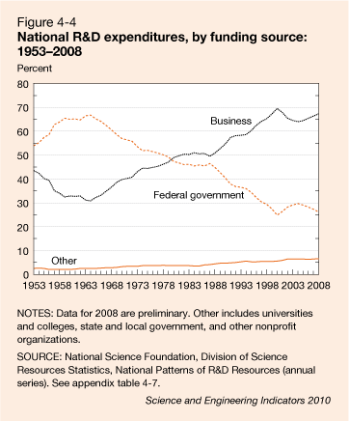
Industry Commitment to R&D
$398B
Notes:
RD

Slide 27
R&D Funders Upward Trend Continues
Notes:
RD

Slide 28
The Source-Performer Matrix Estimated Distribution of U.S. R&D Funds in 2014 Billions of Current U.S. Dollars (Percent Change from 2013)
 | Performer
Source | Federal Gov | FFRDC (Gov) | Industry | Academia | Non-Profit | Total
Federal Gov | $35.7 1.0% | $16.5 1.1% | $27.8 1.1% | $37.1 2.5% | $6.0 1.1% | $123.0 1.5%
Industry |  | $0.3 0.7% | $302.5 4.1% | $3.3 1.7% | $1.4 0.5% | $307.5 4.0%
Academia |  | $0.1 0.1% |  | $13.2 2.0% |  | $13.3 1.9%
Other Gov |  | $0.0 0.1% |  | $4.0 1.1% |  | $4.0 1.0%
Non-Profit |  | $0.1 0.2% |  | $5.3 2.2% | $11.3 4.0% | $16.7 3.4%
Total | $35.7 1.0% | $17.0 1.0% | $330.3 3.8% | $62.9 2.2% | $18.7 2.7% | $464.5 3.2%
Source: Battelle, R&D Magazine

Slide 29
Total Commitment to R&D from Business/Industry
$259 2010
$270 2011
$280 2012
?$311? 2013
$330 2014 (projected)
in billions
Source: Batelle, R&D Magazine

Slide 30
2013 ????
R&D funded by U.S. academia is forecast to increase by 2.1% in 2013 to $12.7 billion
R&D performed by U.S. academia (all sources) increases by 0.4% to $66.6 billion
2013 projected performance reflects:
1) reduced Fed support – sequestration
2) slower US economic growth
3) termination of American Recovery and Reinvestment Act funds which, after three years --$18 billion in R&D stimulus funds
Notes:
RD

Slide 31
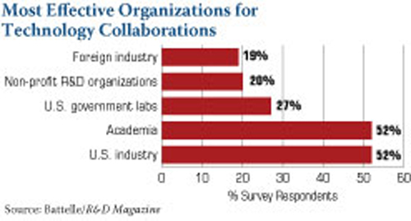
Most Effective for Collaboration
Most Effective Organizations for Technology Collaborations
Foreign industry
Non-profit RSD organizations
U.S. government labs
Academia
U.S. industry
19%
20%
27%
52%
52%
0 10 20 30 40 50 60
% Survey Respondents
Source: Batteile/R&D Magazine

Slide 32
The Emphasis on Competitiveness, Job Creation, and Economic Recovery

Slide 33
Components
Workforce Development
Economic development
Institutional intellectual property to the
market
Local entrepreneurs linking to campus
Collaboration on loan and start-up funding
Community Development
Health care, K-12, social service
collaboration
Civic engagement
Healthy social environments
© AAASC/GRC, 2013
Notes:
Identify what DOE/DOL is doing along the lines of workforce/economic/ and community development (energy related program highlights)
33

Slide 34
National Science Foundation
Growing emphasis on crosscutting and interdisciplinary collaboration agency-wide.
Some initiatives require partners from multiple departments and institutions.
Even when not required, well-coordinated collaborations can increase a proposal’s competitiveness.
Priority programs include Partnerships for Innovation: Accelerating Innovation Research, which supports technology translations and research alliances, and Interdisciplinary Research in Hazards and Disasters (Hazards SEES).

Slide 35
Corporation for National and Community Service
Highlights of CNS’ FY 12 Budget
$400 million for the continued expansion of AmeriCorps State and National to almost 80,000 participants
$70 million for the Social Innovation Fund to increase non-profits’ capacity to offer services in high-need communities
FY 13 Total Request of $1.063B, up from $1.048B
No cuts for AmeriCorps or Social Innovation Fund
© AASCU/GRC 2013
Notes:
1% increase in FY13 proposed; The Volunteer Generation Fund and the Nonprofit Capacity Building Fund have been deemed low priority and eliminated. Most CNS programs are partnerships...Social Innovation Fund makes grants to large non-profits like United Way…IHEs may apply for sub-awards.

Slide 36
USDA
Plant, animal, food science
Plant Feedstock Genomics for Bioenergy: A Joint Research Funding between USDA, DOE
Defense
The Deployed War-Fighter Protection research program (DWFP): Joint Research funding between DOD and USDA
Economic Development
Rural Cooperative Development Grants (RCDG)
Rural Business Opportunity Grants (RBOG)
Health Care
Rural Health and Safety Education Competitive Grants Program
The Distance Learning and Telemedicine Loan and Grant Program (DLT)
Notes:
All programs are updated here 12/31.

Slide 37
DOL and ED Collaborate on Youth CareerConnect Program
U.S. Departments of Labor and Education launched $100 million to the new Youth CareerConnect
Funds public/private partnerships of public to improve high school graduates’ college- and career-readiness, particularly in STEM – match required
Program emphasizes: integrated academic and career learning; work-based learning/employer engagement; integration of post-secondary education/training
Applications due January 27, 2014

Slide 38
Inter-Agency Inter-Disciplinary Inter- Institutional Partnerships

Slide 39
Labor & Education
The Trade Act Assistance Community College Career Training (ETA) program
NSF & DOE
Quantum Energy and Sustainable Solar Technologies (QESST) program
NSF & NIH
Advancing Health Services through System Modeling Research
Notes:
I added NEH and NSF programs Digging Into Data (http://www.diggingintodata.org/) and Documenting Endangered Languages (http://www.neh.gov/grants/preservation/documenting-endangered-languages)

Slide 40
NEH Interagency Partnerships
Documenting Endangered Languages
Jointly administered between NEH and NSF, awards fellowships, dissertation grants, and institutional grants. Deadline September 15, 2014.
Let’s Talk About It: Muslim Journeys
Partnership between NEH and American Library Association granted funds and materials to 125 libraries and state Humanities Councils for reading and discussion groups
Digging Into Data
Partnership between NEH, Arts & Humanities Research Council, Economic and Social Research Council, IMLS, NSF, and other British, Canadian, and Dutch agencies to addresse how "big data" changes the research landscape for the humanities and social sciences.
© AASCU/GRC 2014
Notes:
There have been three rounds of Digging into Data so far – 2014 challenge not released yet. Let’s Talk About It may take on a new topic in 2014 (previous were Civil War and Muslim Journeys

Slide 41
NEA Partnerships
National Arts and Humanities Youth
Program Awards
Recognizes the accomplishments of arts and
humanities after-school and out-of-school
programs with $10,000 awards
The Big Read
Partnership with Arts Midwest to restore
reading to the center of American culture
with awards of $2,500 to $20,000. Deadline January 28, 2014
The Arts and Human Development
A new task force of 13 federal agencies including divisions of HHS, NIH, NSF, Dept. of Ed, and IMLS designed to examine links between the arts and positive developmental, behavioral, and social outcomes
The task force shares latest research in quarterly webinars
© AASCU/GRC 2014

Slide 42
Federal Interagency Working Group on Environmental Justice (EJ IWG)
Established in 1994, the EJ IWG guides, support and enhance federal environmental justice and community-based activities.
For EPA's strategy and progress report, please refer to Plan EJ 2014.
Comprised of 17 federal agencies and several White House offices.
Environmental Protection Agency (Chair)
Department of Agriculture
Department of Commerce
Department of Defense
Department of Education
Department of Energy
Department of Health and Human Services
Department of Homeland Security
Department of Housing and Urban Development
Department of Interior
Department of Justice
Department of Labor
Department of State
Department of Transportation
Department of Veteran's Affairs
General Services Administration
Small Business Administration
White House Offices
Notes:
Working group still in full effect. Here is the FY 14 plan: Plan EJ 2014

Slide 43
NIH/Building Infrastructure Leading to Diversity (BUILD) Initiative
Major initiative to support multi-institution partnerships involving many types of campuses:
Applicant (primary institution): baccalaureate-granting colleges/universities that receive less than $7.5 million of NIH research project grant (RPG) funding annually and have at least 25% of their students supported by Pell grants
Pipeline Partner - two- or four-year undergraduate institutions
Research Partner -
Deadline expected in early to mid 2014 – 10 awards

Slide 44
NIH and NSF Focus on Neuroscience Research
National Institutes of Health (NIH) and National Science Foundation (NSF) --complimentary projects on neuroscience
NIH focuses on increasing awareness of and participation in neuroscience
NSF emphasis on innovative science research integrating multiple disciplines.

Slide 45
?
?
?
Questions
?
?
?

