Slide 1
The How and Why of DOI
Assigning DOI’s to IR content
Jennie vance, ir specialist
JJ Johnson, Ils manager

Slide 2
Digital
Object
Identifier
“A digital object identifier is a unique alphanumeric string assigned by a registration agency to identify content and provide a persistent link to its location on the Internet.”
--APA Style Blog

Slide 3
Why?
Access
Persistent link
Credibility
Enhances the profile of your journals
Compliance
Grant requirements
Discovery
Additional exposure
Notes:
Why have DOI’s (everyone)
Access-Persistent link across platforms, if the journal moves from platform x to platform y the link remains
Credibility-Indexes require DOI before inclusion
Discovery-Vendors share metadata with partner organizations Compliance-Meets certain grant requirements

Slide 4
Why USM has DOI’s
Journal publishing
Datasets
Finding Aids
Notes:
Why USM has DOI’s:
Journal publishing in Aquila
Gulf and Caribbean Research
Datasets-Requests by GIS faculty to fulfill journal requirements for publishing data
Finding Aids-Persistent links were needed for migration to a new platform

Slide 5
Life Cycle of a DOI
Author creates content
Submits content to publisher
Publisher assigns DOI
Publisher posts DOI
Publisher updates metadata
Notes:
An author creates content then submits to publisher
publisher assigns DOI and registers with a vendor. The DOI provides a stable, persistent link to the content
Publisher posts DOI and link to landing page for the original content
Publisher submits metadata updates as needed

Slide 6
DOI Registration Agencies
Scholarly and Professional Research Content
“Focused on improving the scholarly infrastructure around datasets”
Registry of movies, television shows, etc
Notes:
There are a few vendors to choose from for registering DOI’s. The following are some of the more popular U.S. options. Each vendor has different policies and costs. You need to research each to determine what pricing model or policies fit your needs.

Slide 7
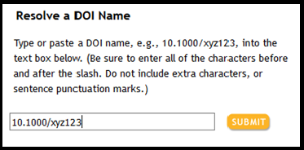
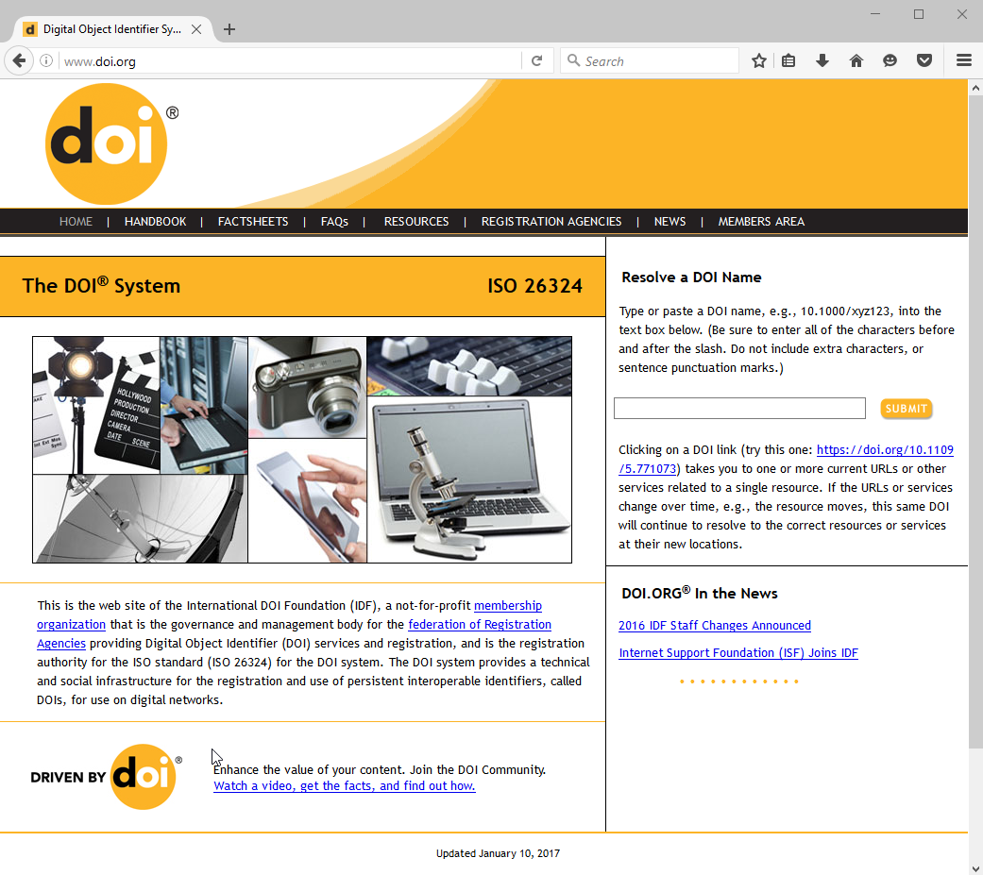
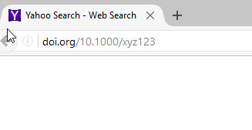
How to Resolve a DOI Name

Slide 8
DOI names are made of three parts:
Directory Indicator
Registrant Code
Suffix
Notes:
Directory Indicator-Vendor Registrant Code-Institution Suffix-Specific Content
RA Control vs Institution Control over suffix naming Journal Prefix + Volume/issue + article → EX: GCR.2801.01

Slide 9
CrossRef Requirements
Outbound linking
If you post an article with a DOI number, you have 24 hours to submit it
DOI resolution reports
Must link to a landing page describing the article content
Landing page must also contain the DOI
Notes:
Outbound linking → citations within the article you submit to crossref must contain DOI links if they exist. Ex: if I cite another journal article within my article, I have to included that DOI link in my citation. This applies to just journal articles. Not needed for book citations, or newspapers, ect…
24 → this helps prevent posting DOI numbers that have not been registered and go to a 404 error page
Resolution reports → provides usage information regarding how many times a DOI link is clicked as well as any errors (can be either a problem with the metadata or user error)

Slide 10
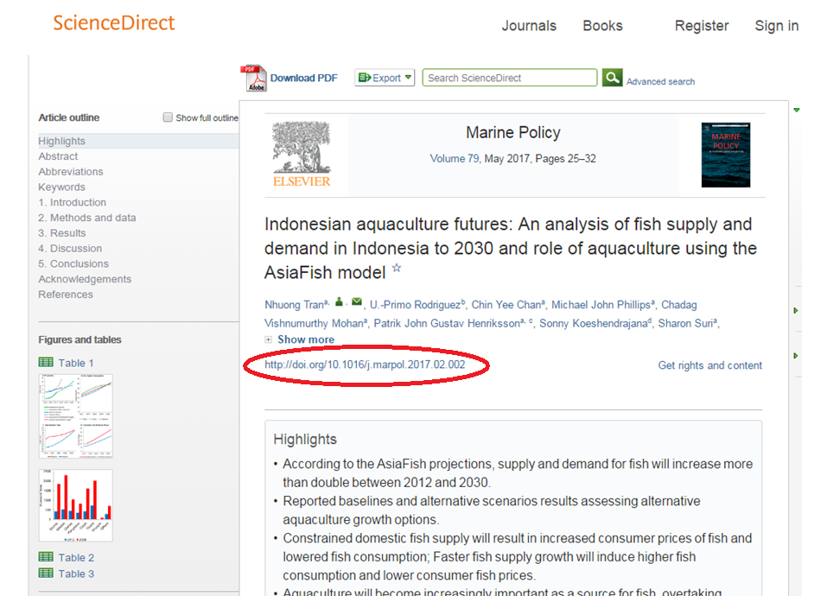

Slide 11
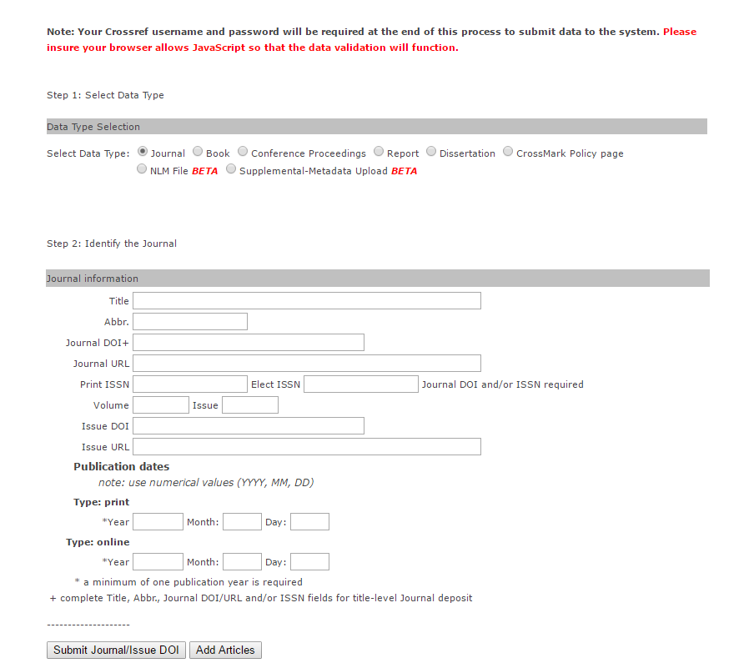
Submitting Metadata
Option 1:
Use the web form to manually enter metadata for each journal volume
Notes:
Options after reading through documentation…..
This is used more for individually published articles whereas full issues and back issues it would be better to automate
Option 1: *This could be a lot of fun if you need to submit a large number of back issues*

Slide 12
Listserv
Digital Commons was a great resource for information
XML Editors
Several open source and proprietary XML editors are available. It depends on personal preference such as whether you want a GUI interface or if you are happy with collapsible nodes and using plugins through a text editor.
Comparison of editors
http://www.gutenberg.us/articles/comparison_of_xml_editors
https://en.wikipedia.org/wiki/Comparison_of_XML_editors
Notes:
Reached out to the Digital Commons listserv for help getting started- Isaac Gilman at Pacific University (Oregon) shared information received from Janice Chan at Edith Cowan University (ECU) (Australia)

Slide 13
XML
XML Editor
XML
XML ready to submit
Create XSLT that will format harvested XML to meet schema requirements
Harvested from source
Option 2:
Automate some of the process with code
Option 3: A little creative coding with your favorite language and Excel
Notes:
*demo of process using oxygenxml
*demo of process using perl to transform finding aid information

Slide 14
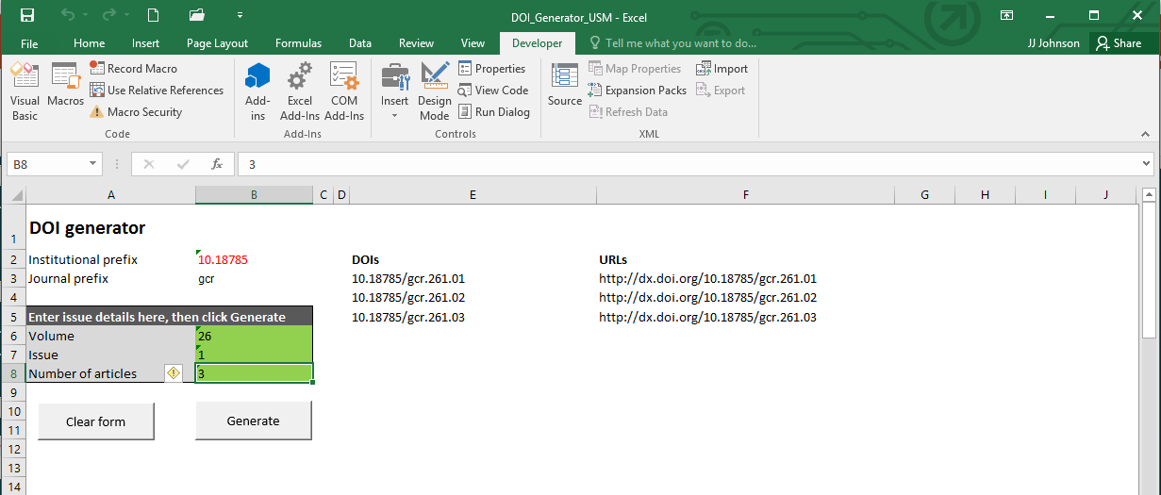
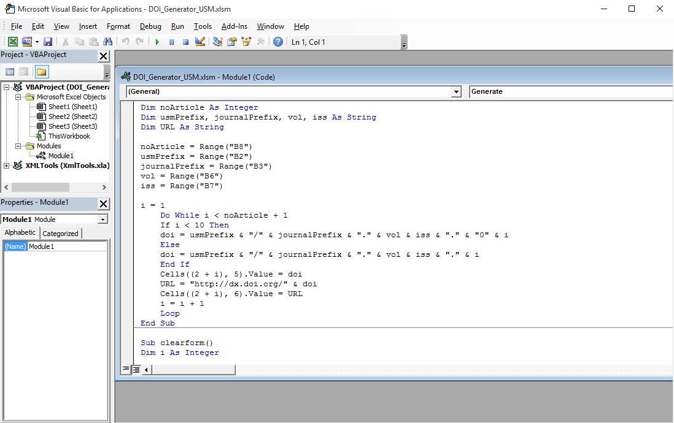
Using Excel
Assist with generating DOI numbers
Helpful when batch loading DOI numbers to IR
Notes:
Part of the information shared was a nifty VB program in Excel to help with generating DOI numbers
*changed it a little from the original - customized for our naming convention

Slide 15
Getting a Little Creative with Excel and Scripting Example
Problem:
Assigning DOI numbers to finding aids for the purpose of having persistent links
Solution:
A mixture of scripting and Excel
ContentDM
Export required fields into Excel
Script
Read each row, assign variables and print to a .xml file
Create XML files
Submit each file
Notes:
Option 3…. McGyver approach
Digi could easily export finding aid records from contentDM into Excel. After checking incoming fields, I saved to a comma separated text file.
Used Perl to read each row and assigned variables by splitting at the comma. Hard coded the xml tags and created a separate file for each row
Submit files
This is just the way I approached the problem based upon how I could get the files and quickly transform a small, fixed number of fields. This option would not work well if you have a file with an unspecified number of fields. Using the web form was not an option and CrossRef does not have a schema listed on their website specific to finding aids. I used the posted content schema with a few required fields.

Slide 16
Resources
APA Style Blog-”What is a digital object identifier, or DOI?”
http://www.doi.org/registration_agencies.html - Registration Agencies
http://ezid.cdlib.org/learn/crossref_faq
https://www.crossref.org/webinars/#contentreg – webinar about content registration
https://www.crossref.org/get-started/content-registration/ - content registration guide
https://github.com/gilmani/oaipmh_jats - Isaac Gilman’s Repository
https://github.com/icecjan/bepress-crossref-doi - Janice Chan’s Repository
jenniferjohnson@usm.edu - JJ, University Libraries, contact information for Perl code or other questions

Slide 17
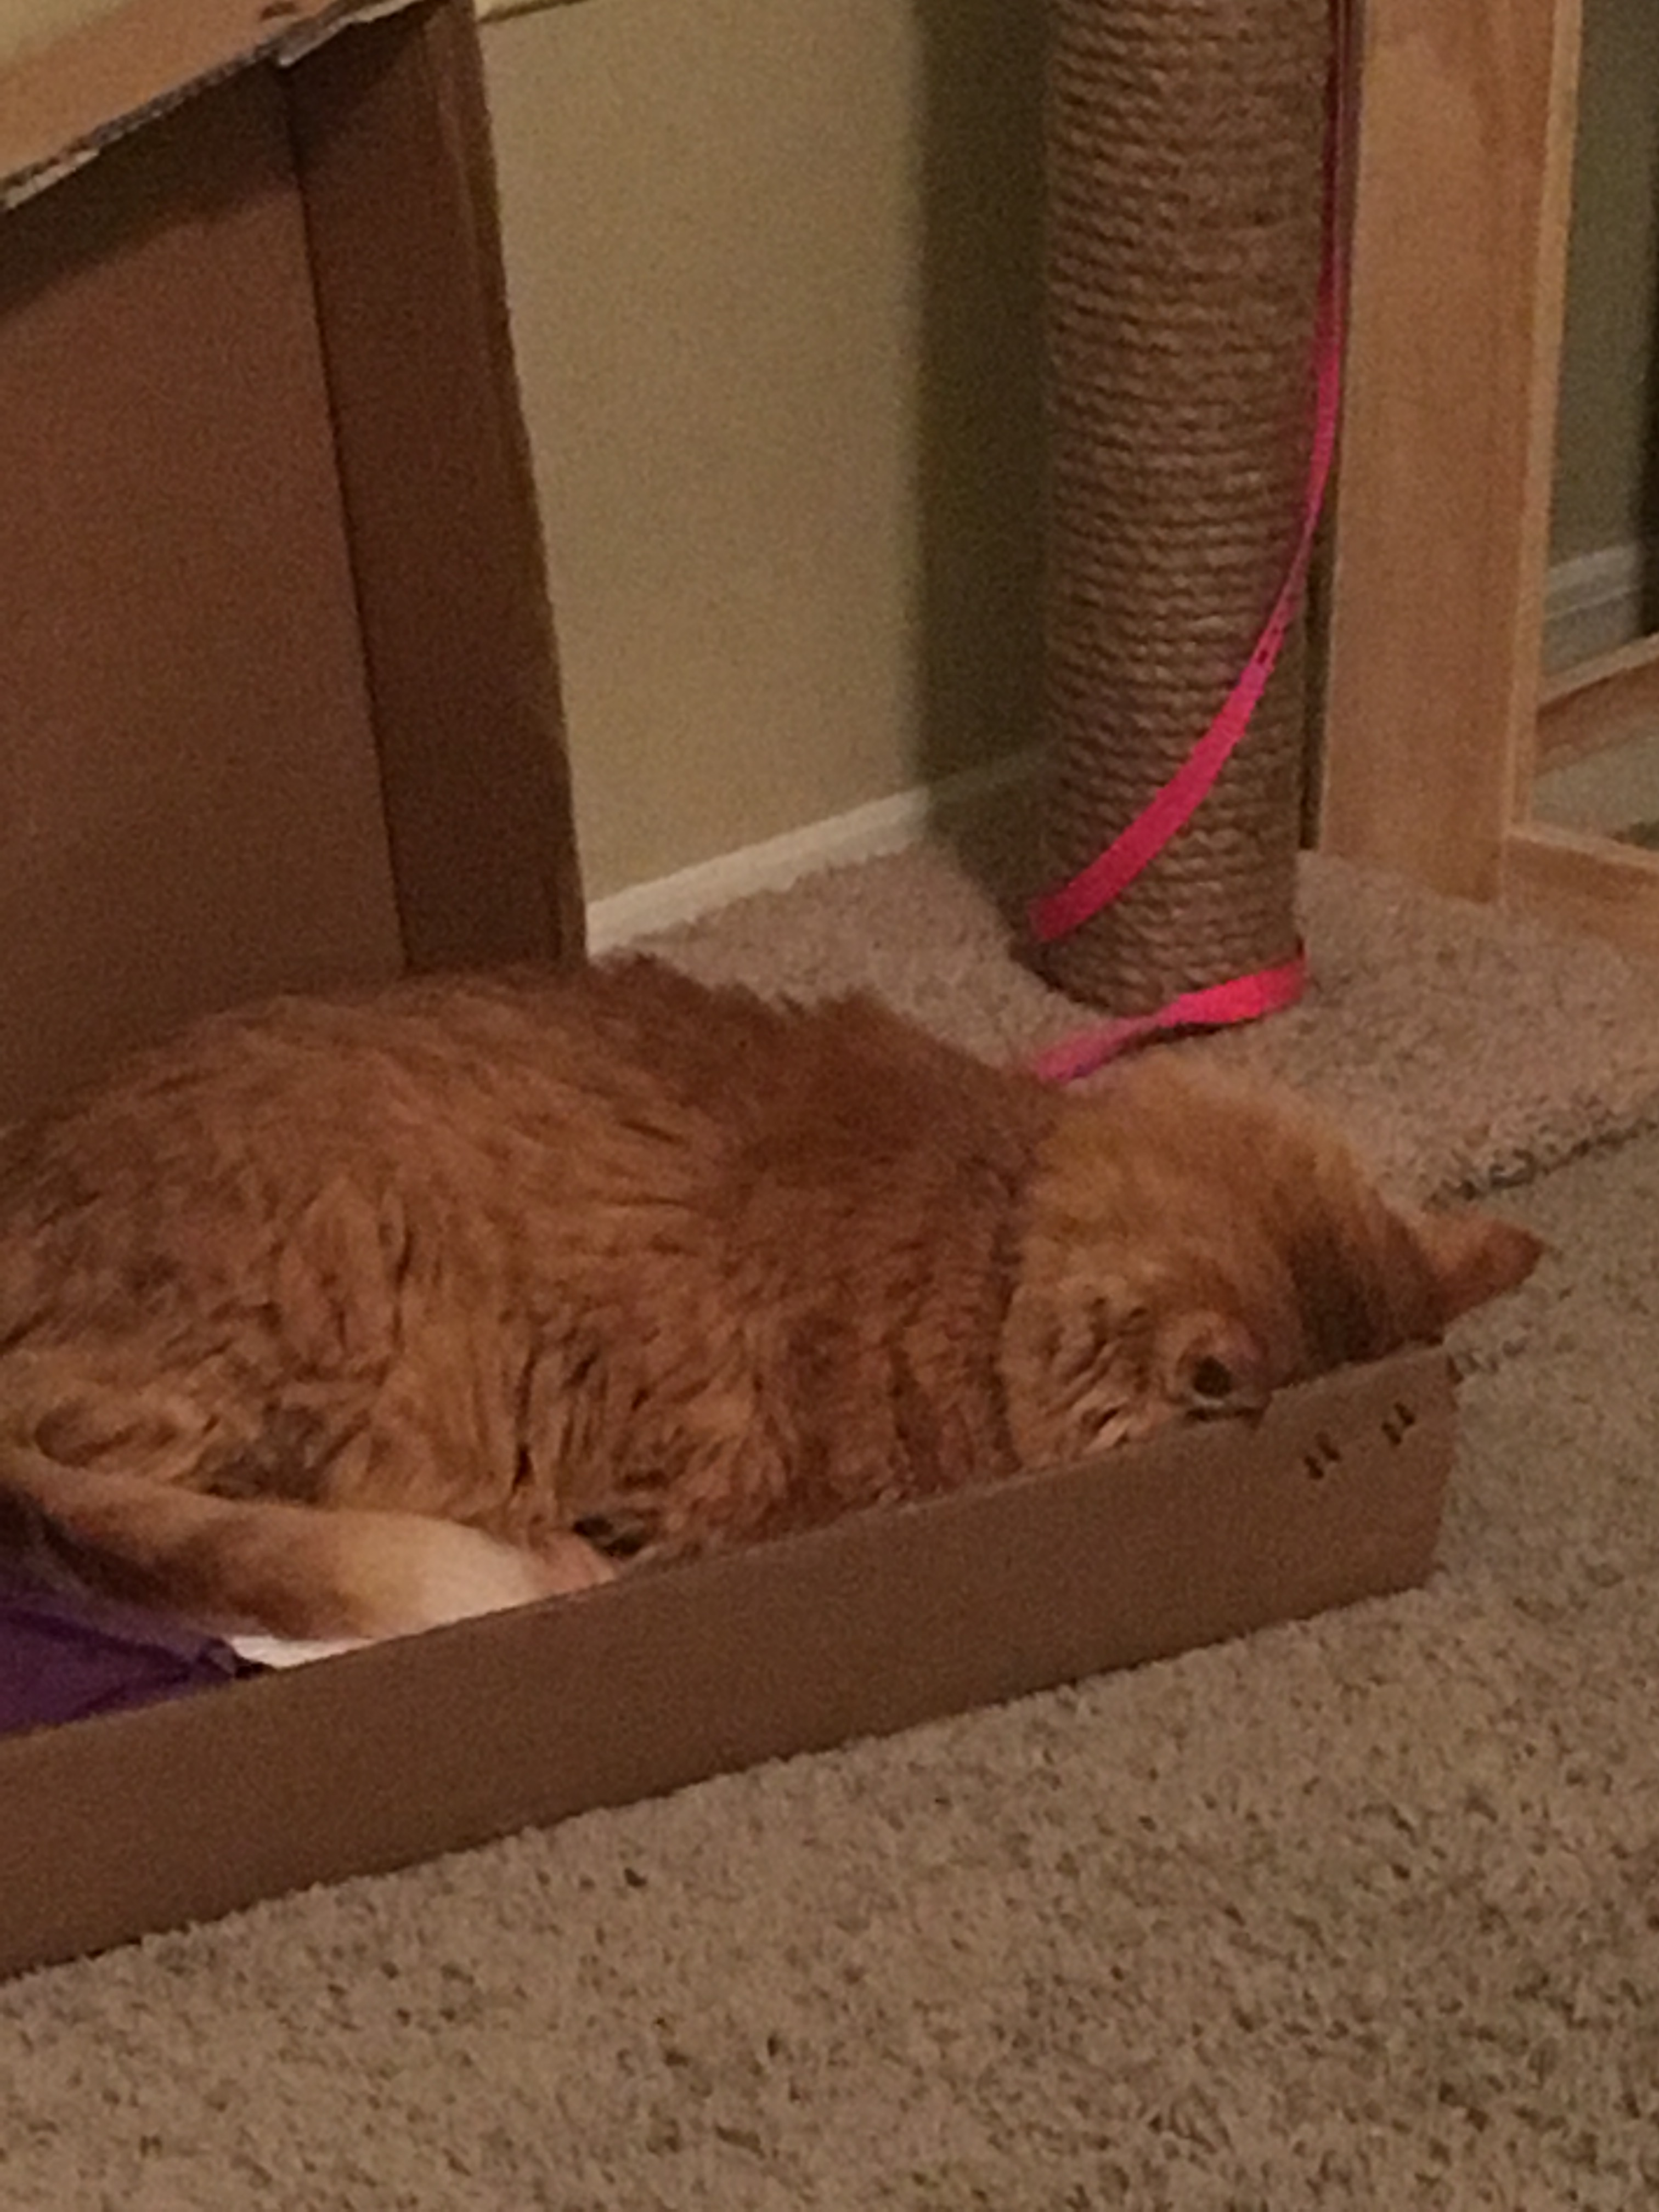
Notes:
Butters the cat

